Slide 1
CSE 574 Lecture 16: Partial Observability
Professor: Stephanie Gil
Email: sgil@asu.edu (Office hours M 12-1pm BYENG 386)
TAs: Sushmita Bhattacharya sbhatt55@asu.edu (Office hours M 5-6 BYENG 392)
Weiying Wang wwang239@asu.edu (Office hours Th 2:30-3:30 BYENG 392)

Slide 2
Last Time
Feature-based learning
How to infer the values of states that you haven’t visited

Slide 3
Today
“Just when I learn the answers they change the questions”
What to do when you don’t know your current state

Slide 4
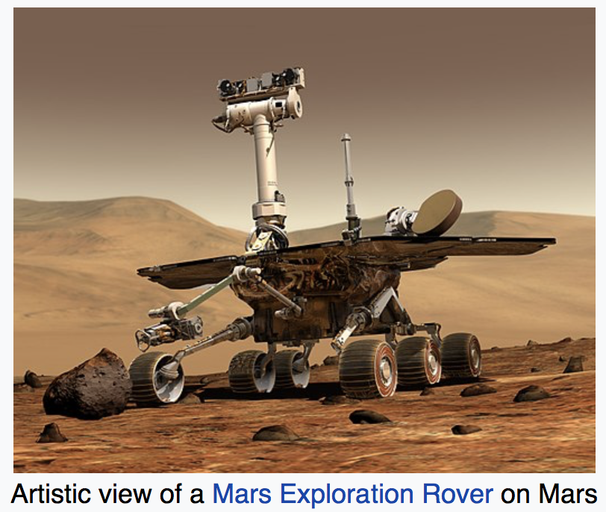
Examples: NASA MER
Mars Exploration Rover Spirit Wheel
p=0.5
Failed
Nominal
p=0.5
Source: Wikipedia
p=0.2
S={Failed, Nominal} states
p(s’|s) state transitions

Slide 5
Examples: NASA MER
Mars Exploration Rover Spirit Wheel
p=0.5
p=0.5
Failed
Nominal
p=0.2
Source: Wikipedia
p(E₁|F)
p(E₂|F)
p(E₁|N)
p(E₂|N)
Observations
E₁
E₂
E₁
E₂

Slide 6
Examples: Medical Diagnosis
X_{t}: {Diabetes, noDiabetes}
Another possibility X_{t}: {BloodSugar}
E_{t}: {MeasuredBloodSugar_{t}, PulseRate_{t}}

Slide 7
Example: Weather
X_{t}: {Raining, notRaining}
E_{t}: {Umbrella, noUmbrella}
Russell and Norvig text Fig. 15.2

Slide 8
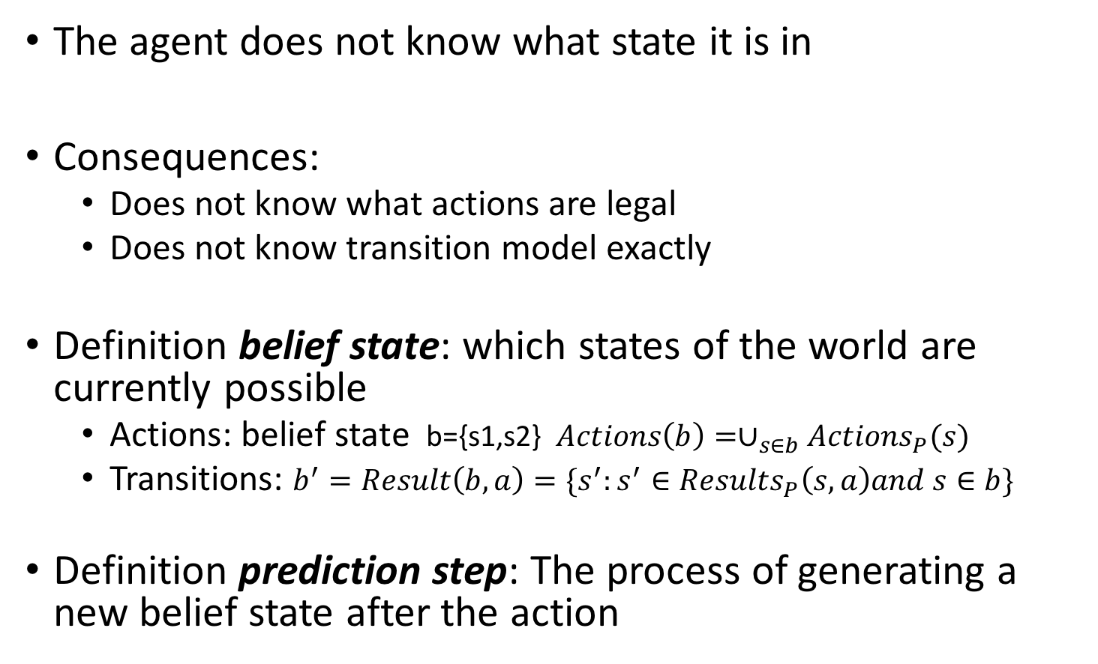
Belief State
The agent does not know what state it is in
Consequences:
Does not know what actions are legal
Does not know transition model exactly
Definition belief state: which states of the world are currently possible
Actions: belief state b={s1,s2} $Actions\left(b\right)=∪_{s∈b}Actions_{P}(s)$
Transitions: $b^{′}=Result\left(b,a\right)=\{s^{′}:s^{′}∈Results_{P}\left(s,a\right)and s∈b\}$
Definition prediction step: The process of generating a new belief state after the action

Slide 9
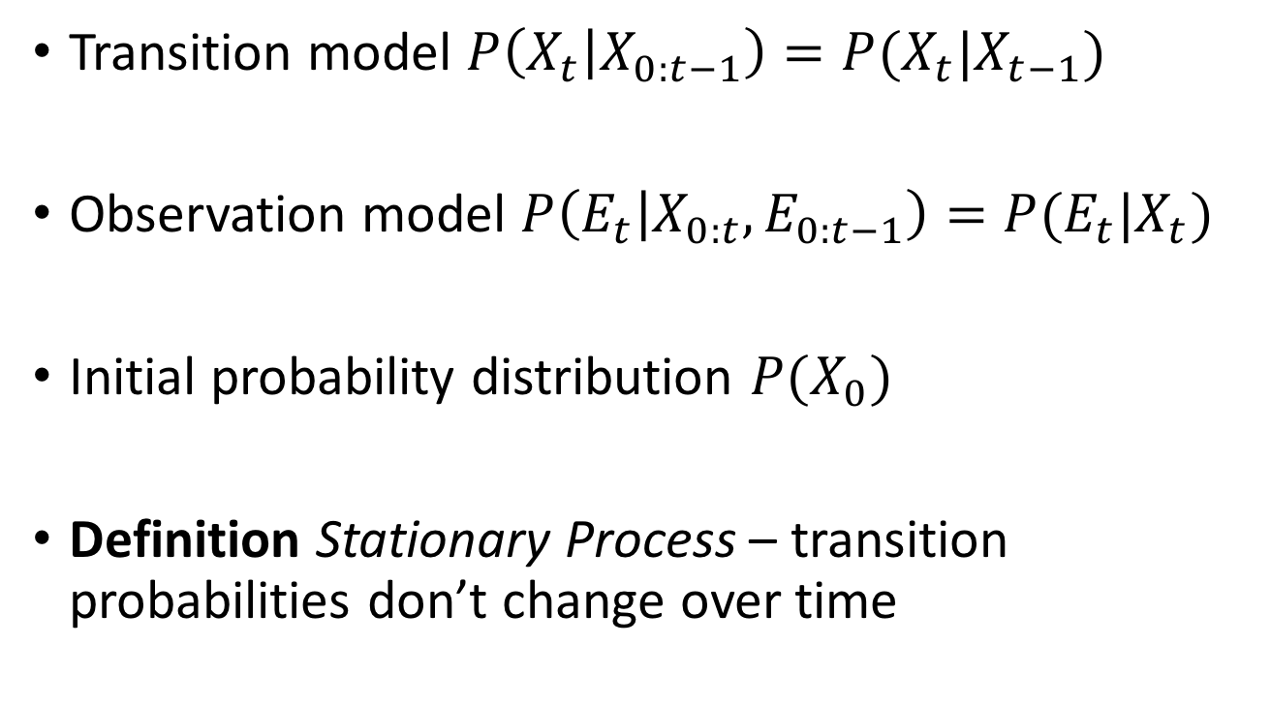
Transition and Sensor Models
Markov assumption
Transition model $P\left(X_{t} | X_{0:t−1}\right)=P(X_{t}|X_{t−1})$
Observation model $P\left(E_{t} | X_{0:t},E_{0:t−1}\right)=P(E_{t}|X_{t})$
Initial probability distribution $P(X_{0})$
Definition Stationary Process – transition probabilities don’t change over time

Slide 10
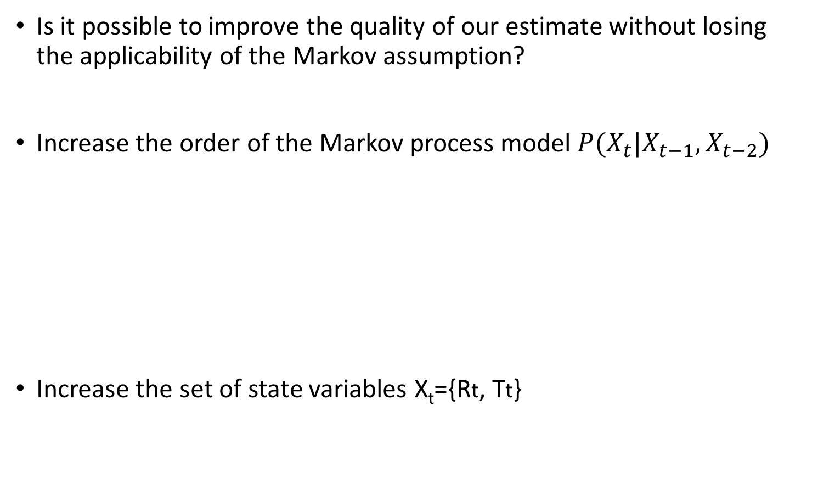
Relaxations to Markov Assumption
Is it possible to improve the quality of our estimate without losing the applicability of the Markov assumption?
Increase the order of the Markov process model $P(X_{t}|X_{t−1},X_{t−2})$
Increase the set of state variables X_{t}={Rt, Tt}

Slide 11
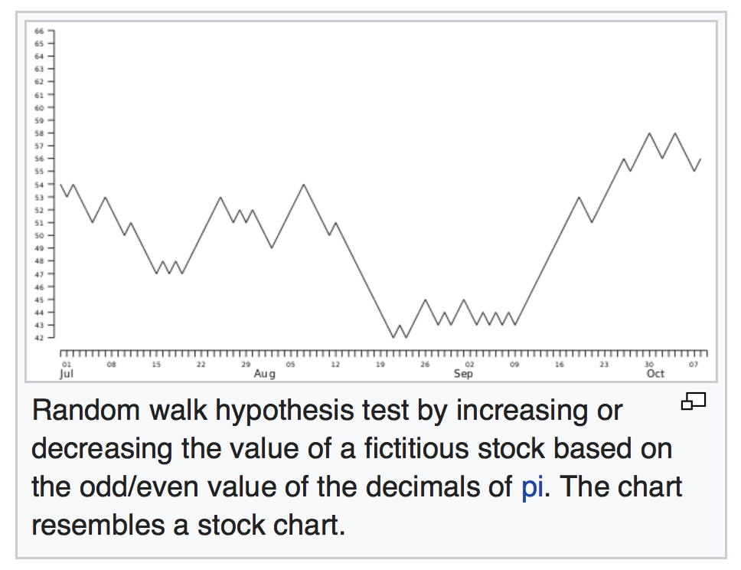
More on the Markov Assumption
Does this assumption ever exactly hold?
Ex: random walk
Source: Wikipedia “Random walk hypothesis”

Slide 12
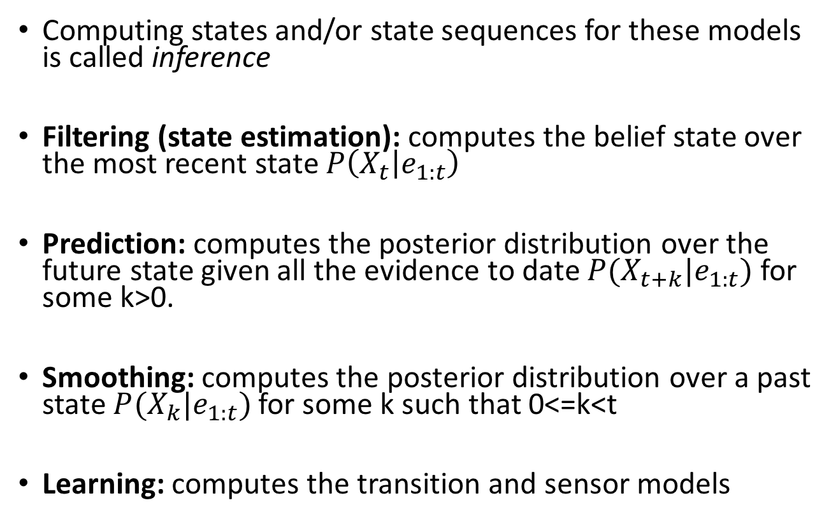
Computations of Interest
Computing states and/or state sequences for these models is called inference
Filtering (state estimation): computes the belief state over the most recent state $P\left(X_{t} | e_{1:t}\right)$
Prediction: computes the posterior distribution over the future state given all the evidence to date $P(X_{t+k}|e_{1:t})$ for some k>0.
Smoothing: computes the posterior distribution over a past state $P(X_{k}|e_{1:t})$ for some k such that 0<=k<t
Learning: computes the transition and sensor models

Slide 13
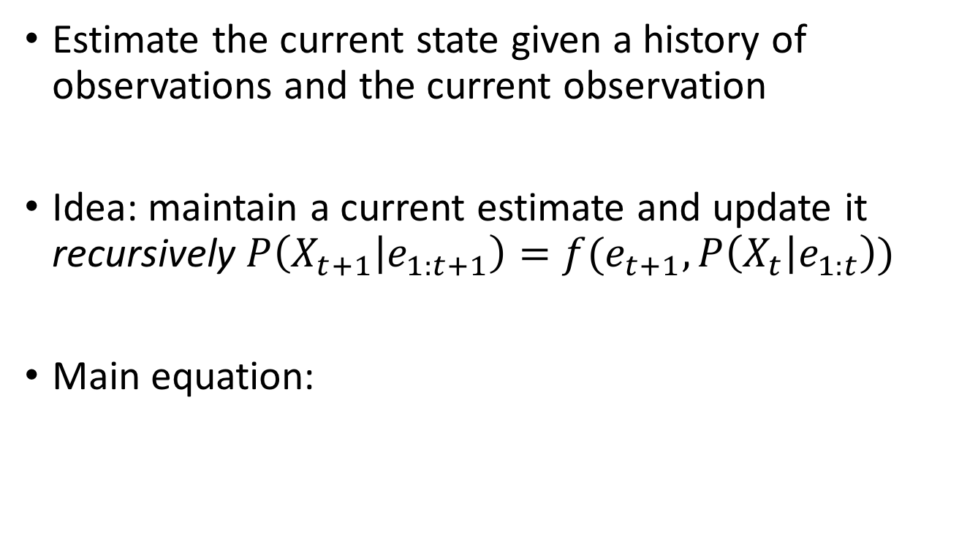
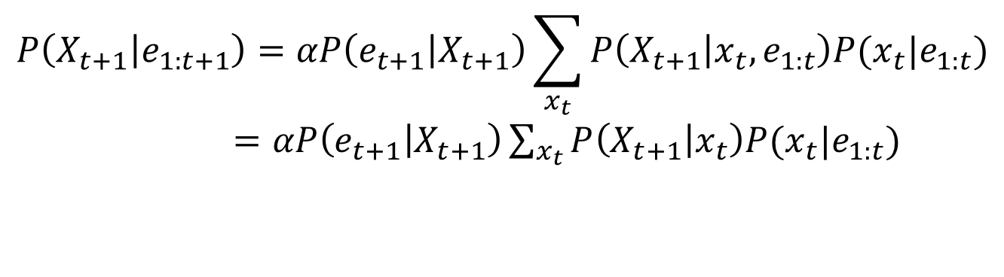
Filtering (State Estimation)
Estimate the current state given a history of observations and the current observation
Idea: maintain a current estimate and update it recursively $P\left(X_{t+1} | e_{1:t+1}\right)=f(e_{t+1},P\left(X_{t} | e_{1:t}\right))$
Main equation:
$$P\left(X_{t+1} | e_{1:t+1}\right)=αP\left(e_{t+1} | X_{t+1}\right)\sum_{x_{t}}{P\left(X_{t+1} | x_{t},e_{1:t}\right)P(x_{t}|e_{1:t})}$$
$=αP\left(e_{t+1} | X_{t+1}\right)\sum_{x_{t}}{P\left(X_{t+1} | x_{t}\right)P(x_{t}|e_{1:t})}$
Markov assumption

Slide 14


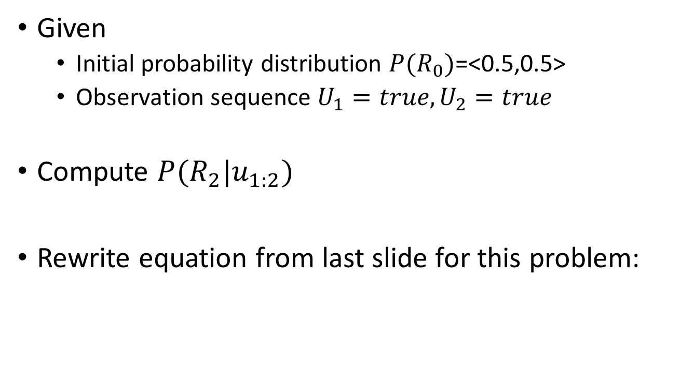
Filtering Example: Rainy Days Problem
Given
Initial probability distribution $P(R_{0})$=<0.5,0.5>
Observation sequence $U_{1}=true, U_{2}=true$
Compute $P(R_{2}|u_{1:2})$
Rewrite equation from last slide for this problem:
$$P\left(R_{2} | u_{1:2}\right)=αP\left(u_{2} | R_{2}\right)\sum_{r_{1}}{P\left(R_{2} | r_{1}\right)P(r_{1}|u_{1})}$$
$$P(R_{2}|u_{1})$$

Slide 15
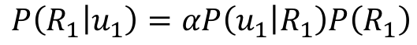

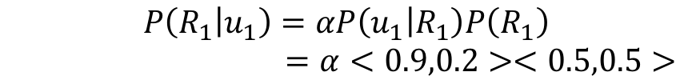

Filtering Example: Rainy Days Problem
What we want to compute:
What we need to compute using given information and initial distribution over the states:
$$P\left(R_{2} | u_{1:2}\right)=αP\left(u_{2} | R_{2}\right)\sum_{r_{1}}{P\left(R_{2} | r_{1}\right)P(r_{1}|u_{1})}$$
Probability of Rain or noRain given observation u₁ (posterior)
$$P\left(R_{1} | u_{1}\right)=αP\left(u_{1} | R_{1}\right)P\left(R_{1}\right)$$
Probability of Rain or noRain given transition probability (prior)
$$P\left(R_{1}\right)=\sum_{r_{0}}{P\left(R_{1} | r_{0}\right)P(r_{0})}$$
$=<0.7,0.3>∗0.5+<0.3,0.7>∗0.5$
$$=<0.5,0.5>$$
$$P\left(R_{1} | u_{1}\right)=αP\left(u_{1} | R_{1}\right)P\left(R_{1}\right)$$
$=α<0.9,0.2><0.5,0.5>$

Slide 16

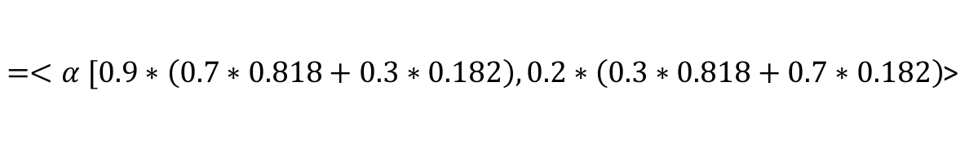
Filtering Example: Rainy Days Problem
Now we have enough information to compute the desired quantity
Transition probability
$$P\left(R_{2} | u_{1:2}\right)=αP\left(u_{2} | R_{2}\right)\sum_{r_{1}}{P\left(R_{2} | r_{1}\right)P(r_{1}|u_{1})}$$
Incorporate evidence
Computed on last slide
$=<α [0.9∗\left(0.7∗0.818+0.3∗0.182\right),0.2∗\left(0.3∗0.818+0.7∗0.182\right)$>
Rain
No Rain

Slide 17
Next Time
Viterbi algorithm
Hidden Markov Models
More inference with hidden state
Reminder: HW 4 is due next week, final project presentations begin in ~2 weeks!

